Slide 1
RTI DDS Pub/Sub with PostgreSQL based Minikube
2023.06.02
김영현(happykimyh9182@skuniv.ac.kr)

Slide 2





Architecture
NodePort Service
ReplicaSet
ReplicaSet
Publisher
Subscriber
Volume

Slide 3

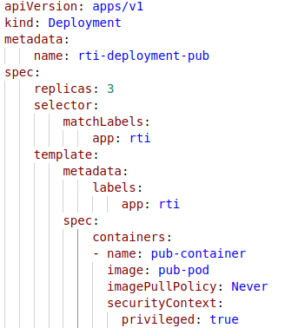
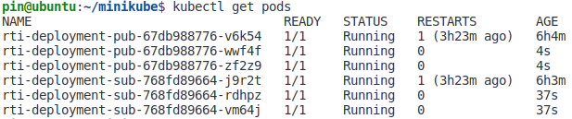
PoC (1/5)
Create ReplicaSet & Deployment
Deployment
ReplicaSet
rti-deployment.yaml
pub&sub pods

Slide 4





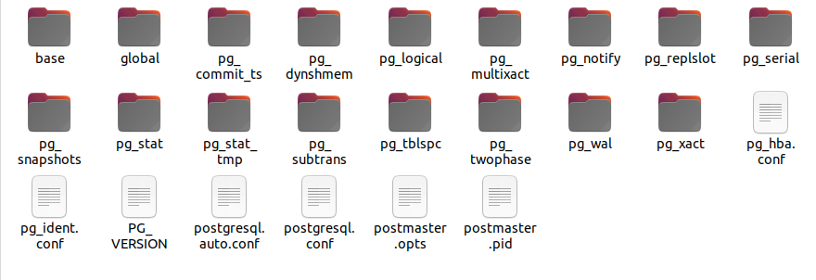
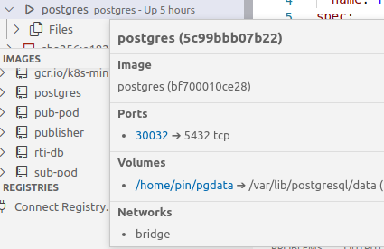
PoC (2/5)
Create Docker Local Volume
File sharing
volume

Slide 5

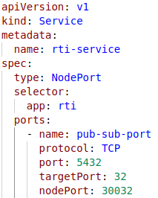
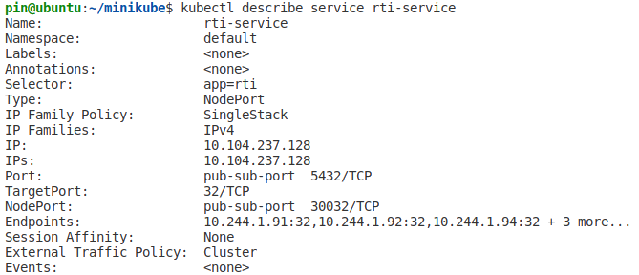
PoC (3/5)
192.168.49.2
nodePort
Create Nodeport Service
Target
Port
Port
Pod
ClusterIP
30032
5432
32
10.244.1.91
10.104.237.128
rti-service.yaml
Pub/Sub & Service ports

Slide 6

PoC (4/5)
Port Forwarding to Database
192.168.49.2
nodePort
Target
Port
Port
Pod
ClusterIP
30032
5432
32
10.244.1.91
10.104.237.128
30032->5432

Slide 7
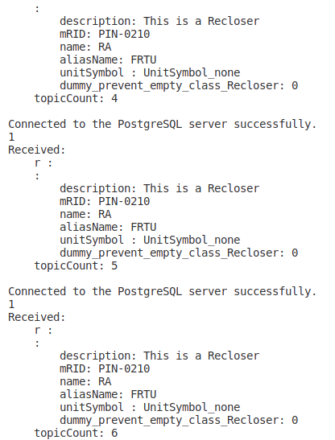
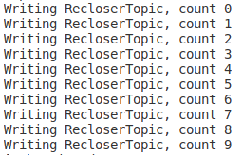

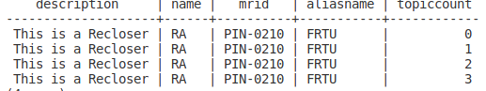
PoC (5/5)
Pod A
(Publisher)
IP Addr : 10.244.1.91:32
Pod B
(Subscriber)
IP Addr : 10.244.1.92:32
Container
(PostgreSQL)
IP Addr : 172.17.0.2:5432
Cluster IP
IP Addr : 10.104.237.128:5432
NodePort
IP Addr : 192.168.49.2:30032
Docker Engine
Minikube
Vmware (Ubuntu)
192.168.136.128:30032
0.0.0.0:30032->5432

